Slide 1
Liskeard place-based package – Site Maps
May 2026

Slide 2
TC proposed devolution assets (subject to ratification and further financial/operational assessments) | Type | Refer to Map
Rapsons Car Park | Car Parks | One
Rapsons Field | Environment | One
Rapsons Play Area | Environment | One
Upper Sungirt Car Park | Car Parks | Two
Lower Sungirt Car Park | Car Parks | Two
Sungirt Valley (Sungirt Valley 1 and a bit of 2) | Environment | Two
POS E of heathlands Road (Sungirt Valley 2 - rest of) | Environment | Two
POS Castle Hill Court & Memorial Site | Environment | Three

Slide 3
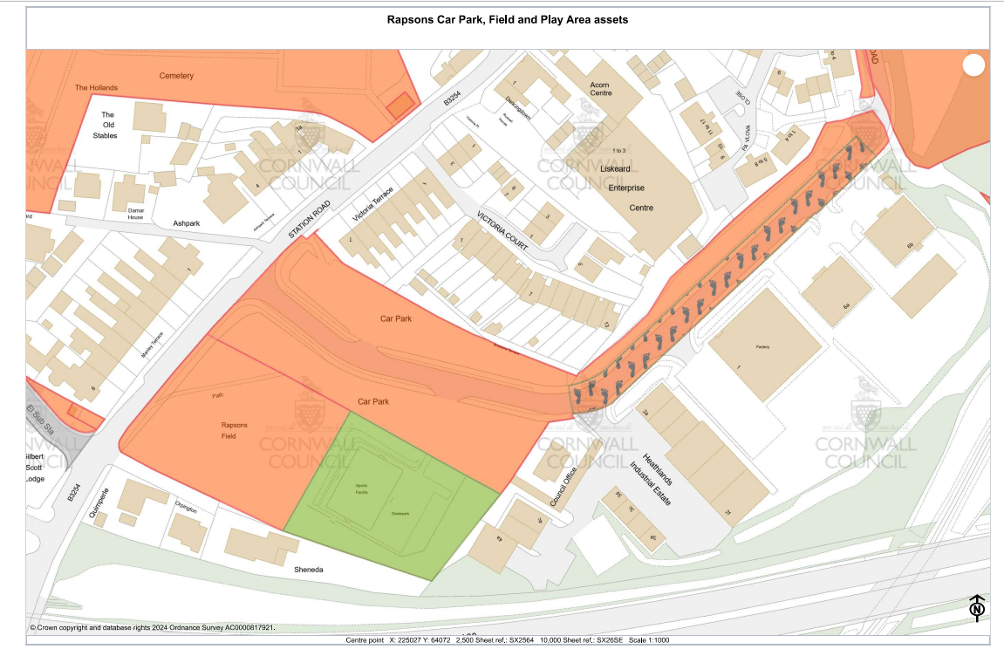
Map one
Rapsons car park
Rapsons field
Rapsons field
play area

Slide 4
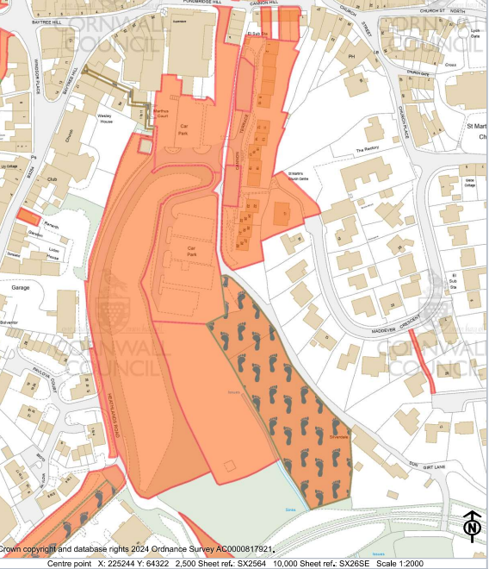
Map two
Upper Sungirt car park
Lower Sungirt car park
This small slip (Land West of Heathlands Road) being regularised with neighbour and not proposed for transfer
POS East of Heathlands Road
Sungirt Valley

Slide 5
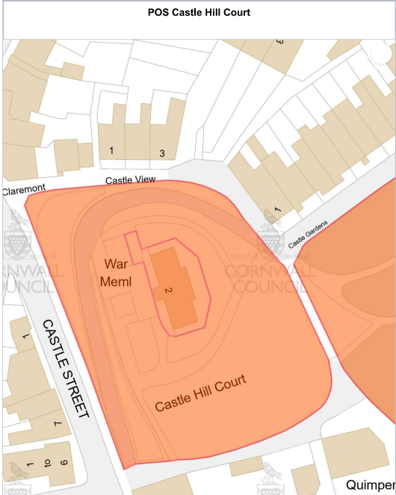
Map three
CHL asset out of scope
POS Castle Hill Court

Slide 6
Play sites and smaller POS / verges for site visits and TC review/assessment | Type | Refer to Map
Culverland Park Play Area | Environment | Four
Pepper Park Play Area | Environment | Five
Land adjacent 27 Springfield Road | Environment | Five
Play Area at Jack Bice Close | Environment | Six
Play Area at Stanley Maggs Way | Environment | Six
Play Area at Silvanus Jenkin Ave | Environment | Six
POS adj Pengover allotments | Environment | Seven
Land at Hendra Park | Environment | Eight
Land adj Liskeard Hospital | Environment | Eight
Land at Maddever Crescent | Environment | Nine
POS at Entrance of Trevillis park / Land at Trevillis Park 1-8 | Environment | Ten
POS (1) Caunter Road - POS | Environment | Eleven
POS (2) Caunter Road – POS | Environment | Eleven
POS adj 58 Dennis Road | Environment | Eleven
POS adj. 5 Stephens Road, Liskeard – POS | Environment | Twelve
POS adj. 26 Stephens Road, Liskeard – POS | Environment | Twelve
POS at Pound Dean (two sites) | Environment | Thirteen
Land at Junction Barras St &Dean St | Environment | Fourteen
POS opposite 2-4 Manley Road – POS | Environment | Fifteen
POS jnc. Manley Road & Station Road, Liskeard – POS | Environment | Fifteen
Land adjoining 37 Bodgara Way | Housing | Sixteen
Land at Killigrew Road | Housing | Sixteen

Slide 7
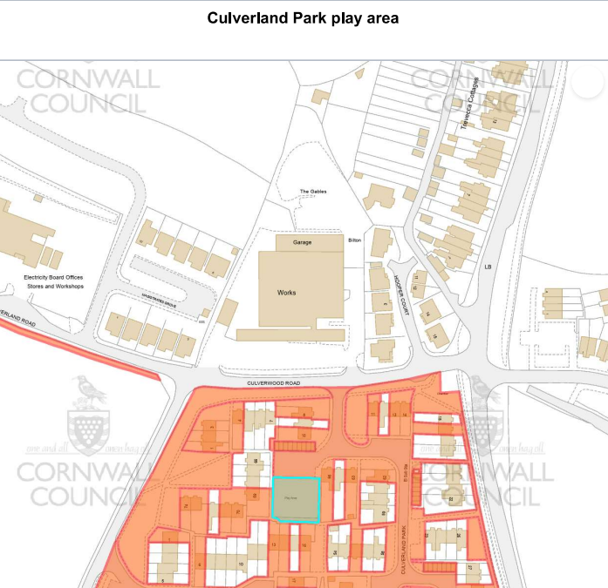
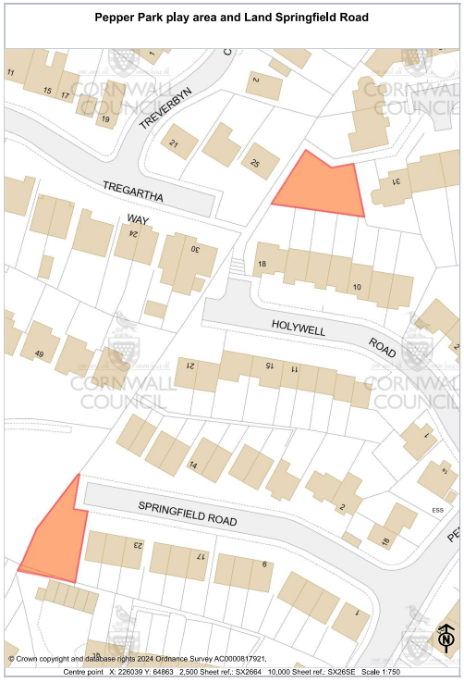
Map four / five
Pepper Park play area (no street view image available)
Culverland Park play area
63 Culverland Park - Google Maps
Land at Springfield Road (no street view image available)

Slide 8
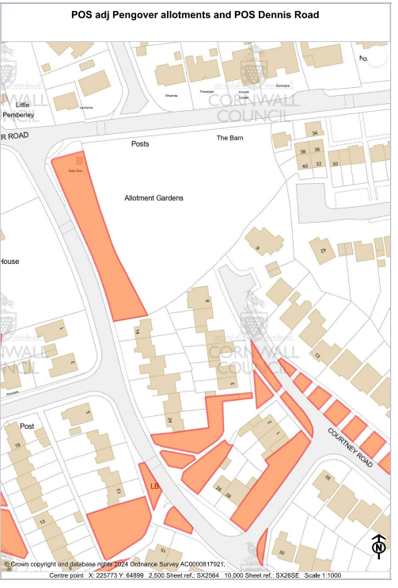
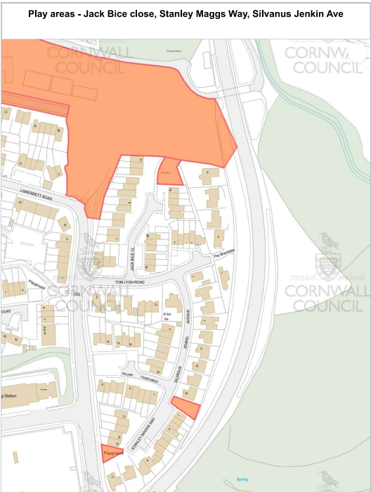
Map six / seven
POS adj Pengover allotments
Jack Bice play area
16 Jack Bice Cl - Google Maps
10 Dennis Rd - Google Maps
Silvanus Jenkin
Play area
1 Stanley Maggs Way - Google Maps
Stanley Maggs Way play area
2 Stanley Maggs Way - Google Maps

Slide 9
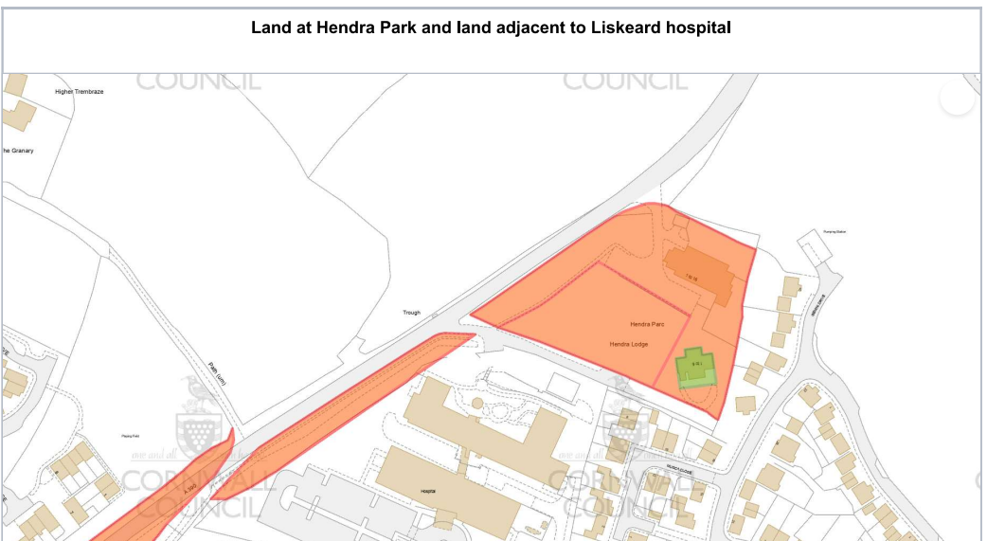
Map eight
Land adj Liskeard hospital A390 - Google Maps
Land at Hendra Park
Liskeard, England - Google Maps

Slide 10
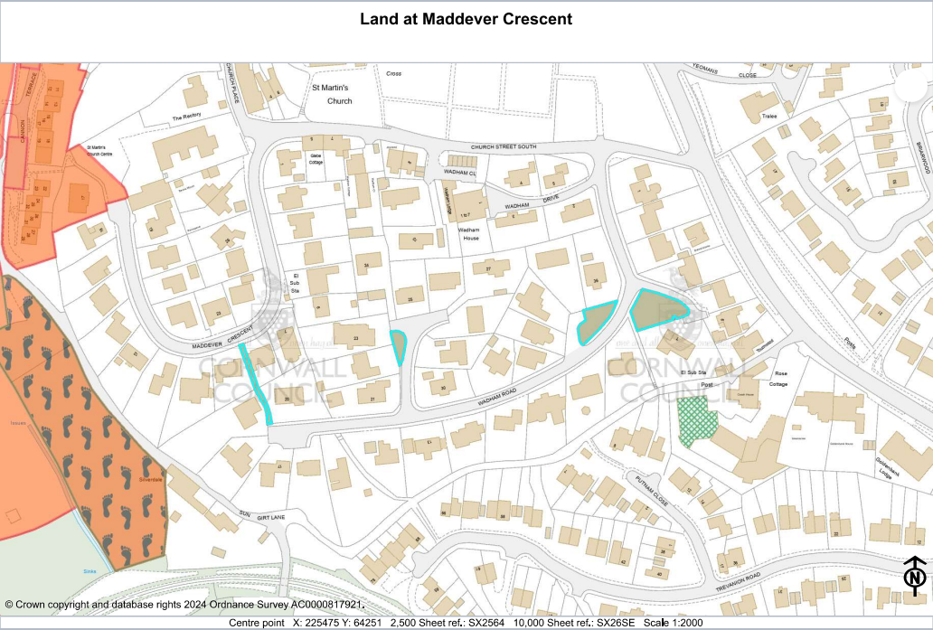
Map nine
20 Wadham Rd - Google Maps
23 Wadham Rd - Google Maps
8 Wadham Rd - Google Maps
8 Wadham Rd - Google Maps

Slide 11
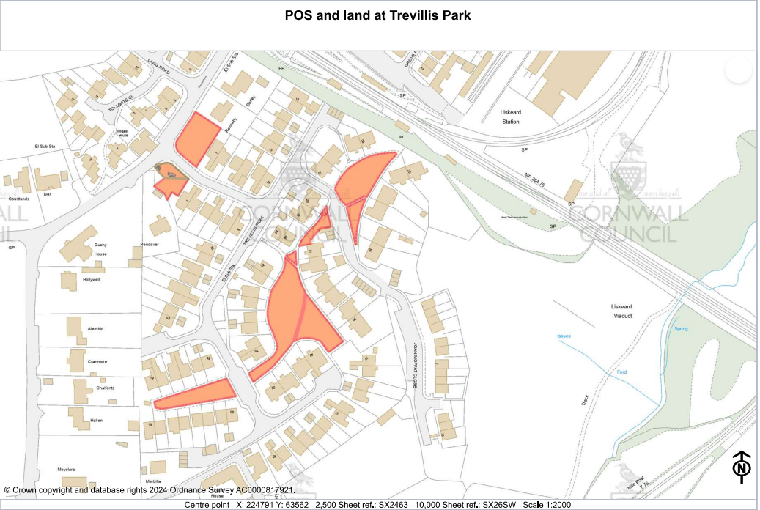
Map ten
All parcels shown on the map, links to sites on street view below:
1 Trevillis Park - Google Maps
31 Trevillis Park - Google Maps
75 Trevillis Park - Google Maps

Slide 12
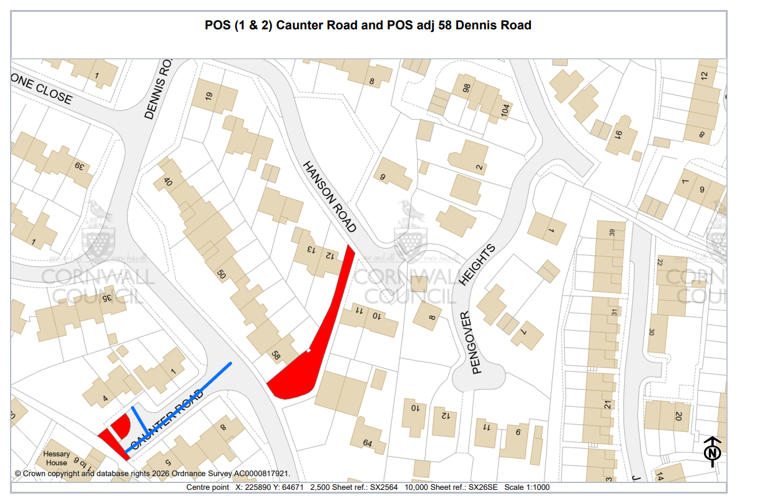
Map eleven
62 Dennis Rd - Google Maps
6 Caunter Rd - Google Maps

Slide 13
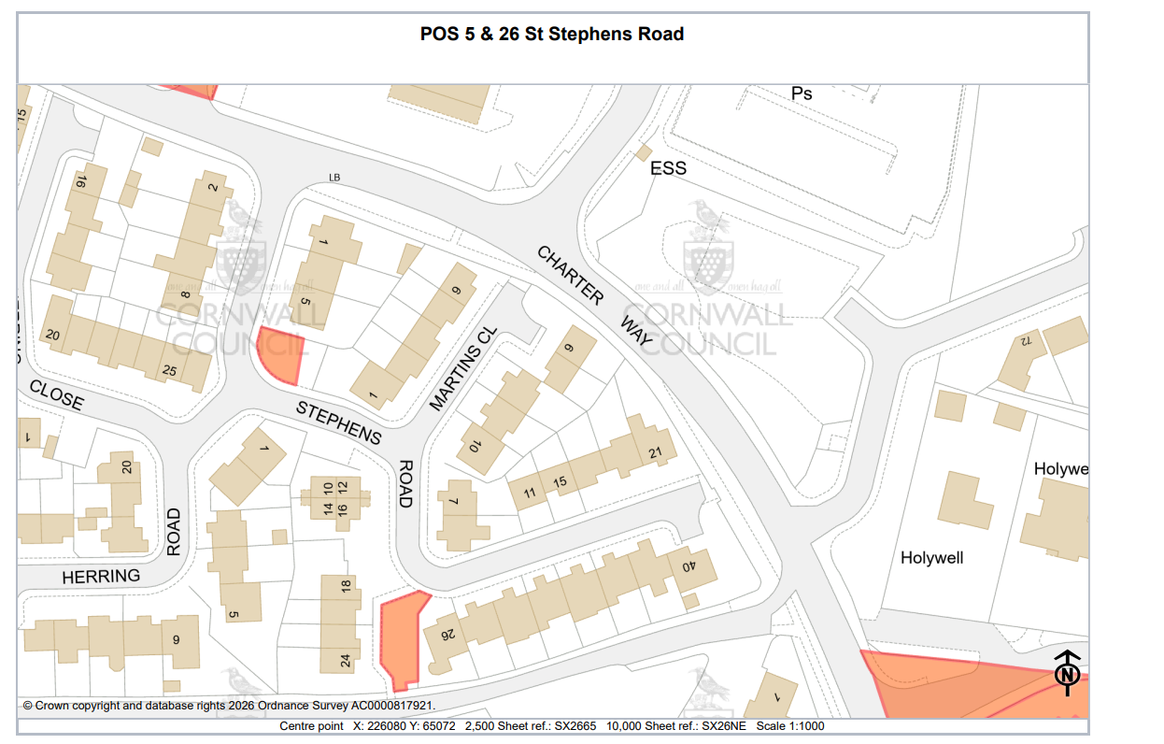
Map twelve
8 Stephens Rd - Google Maps
9 Stephens Rd - Google Maps

Slide 14
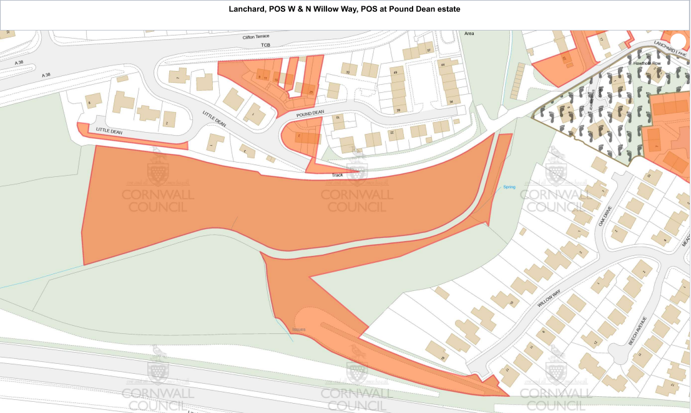
Map thirteen
POS Pound Dean Estate
POS Pound Dean Estate (two sites) – area of encroachment on site being dealt with, remaining parcels for review
8 Little Dean - Google Maps
Little Dean - Google Maps

Slide 15
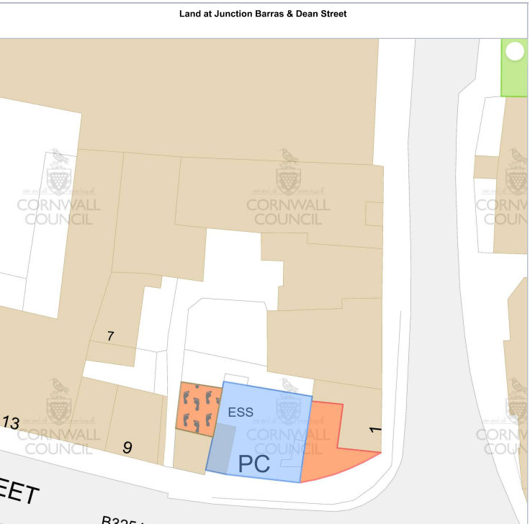
Map fourteen
4 Dean St - Google Maps

Slide 16
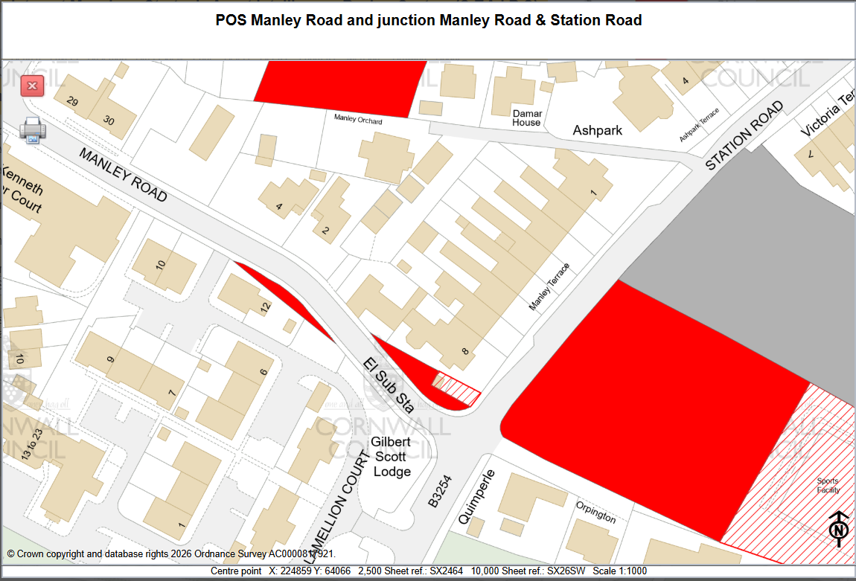
Map fifteen
4 Manley Rd - Google Maps
4 Manley Rd - Google Maps

Slide 17
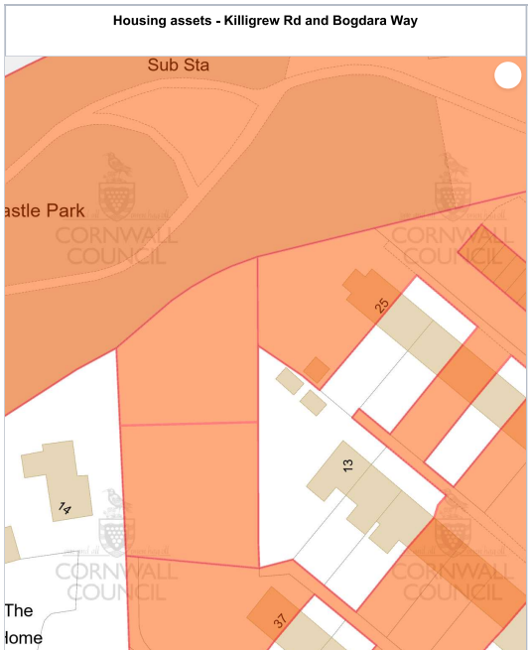
Map sixteen
Land at Killigrew Road
Land adj 37 Bogdara Way
No streetview image available

